Slide 1
Preparatory meeting
Risk-free yield alternatives
Nan Zhou
Financial Sector Specialist
FinSAC-BiHBA Technical Assistance
June 12, 2023

Slide 2
○ Documents reviewed
ABRS
Yield curve of RS debt securities (https://www.blberza.com/Pages/YieldCurveProfile.aspx).
“Methodology for establishing, calculating, and publishing yield curve of Republic of Srpska”.
FBA
Primary auction results of FBiH T-bills and T-bonds.
FBA Annex 16, “Overview of Credit Guarantee Portfolio”.
Debtor-level data on exposures and ECL.
Aim
To generate (long) time series of (daily) average interest rates for BAM to calibrate IR shock scenarios.
BCBS Annex 2: The interest rate used is the average of all daily rates in time buckets {3m, 6m, 1y, 2y, 5y, 7y, 10y, 15y, 20y}.
Instrument mapping / bucketing should be done in parallel.

Slide 3
○ What do we need from this exercise?

Slide 4
○ Broadly possible approaches
Option 1: Using euro area government bond yield curves + adjustments [preferred.]
Further discretions needed regarding the extent of adequate adjustments (sovereign risk, € v.s. non-€)
Enables application of BCBS methodology afterwards.
Option 2: Developing risk-free yield curves using government securities data [ok as benchmark for RS, but to use FBiH primary data only.]
BLBerza example
Enables application of BCBS methodology afterwards.
Option 3: Developing curves using actual interest rate data [possible FBA benchmark.]
FBA Annex 16 on debtor side only. Interest rate measures for bank liabilities (and off-b/s exposures) needed.
Significant methodological adaptations concerning commercial margins and other spread components will be needed.

Slide 5
○ BL Berza treasury yields
Basic information
YtM for RS bonds and treasury bills with maturities ranging from 6m to 10y.
Daily data. First public offering: RS T-bills, May 11, 2011. Publicly available data from January 1, 2013.
Is the variation of interest rates sufficient to reflect possible future volatility? [Yes, this is considered ok.]
Criteria
Bonds and T-bills with market cap > BAM 5m. Bonds: Macaulay (weighted average) duration > 1y.
Bonds with variable coupon rates, inflation-indexed bonds, and other bonds with special features are not included. [Little to none of these types of bonds. Immaterial.]
Methodology
Nelson-Siegel-Svensson, based on optimization of YtM on level, slope and curvature parameters.
Amendment in 2017 to remove liquidity and modify duration validation rules and adopt the use of Macaulay duration instead of maturity of spot rates – there may be before-after differences. [Mind this.]
Replication appears feasible if there is sufficient volume of trade for FBiH. [Likely not.]

Slide 6
○ FBA Annex 16
Some questions on basic information
Length of reporting, update frequency, and expected number of observations per period to be clarified. [3y of reporting, too short.]
Criteria
For risk segmentation: Should we consider a subset of credit positions only (e.g., size of credit position, borrower sector/industry, collateralization)? Can item 12, 14 (credit risk level) identify the least risky part of the credit portfolio? Should ECL (or even financial ratio thresholds) be considered as additional criterion? [For FBA discretion, if decided to undertake this approach.]
Methodology
Part of commercial margins and other spread components will already be captured in the portfolio analysis.
Should we consider taking a similar approach for the rest of the banking book? [No, lack of info.]
If yes, multiple curves will imply multiple shocks. Should they be implemented separately, or be combined for a more compatible application of the IRRBB methodology?

Slide 7
○ Mapping the IR sensitive positions
Besides the IR shock scenario, we would like to suggest the BAs carry out an initial round of mapping of book positions based on your reporting regulation and data, according to the IRRBB methodology.
Afterwards, we can review/comment and approach the template design in connection with the approach discussed previously.
A preferred option would be for us to work with you to construct the interest rate curves prior to the mission and use the prepared mapping and sample data to develop the delta-EVE calculations during the mission.

Slide 8
Preparatory meeting
Risk-free yield alternatives
Nan Zhou
Financial Sector Specialist
FinSAC-BiHBA Technical Assistance
June 29, 2023

Slide 9
○ Data overview
Data sources
Spot rates on euro area AAA-rated government bond securities.
Reconstructed yields for RS government securities based on BLBerza parameter estimates.
Weighted average interest rates from FBiH government securities primary auctions.
Data structure
Dimension = {yield, maturity, time}.
Maturity breakpoints = as defined in BCBS/EBA RTS. Time coverage = 2010-22.
While FBiH auction volumes are available, bid-cover ratio > 1 implies that a Nelson-Siegel-Svenson estimation will overestimate actual yields, as the interest rates accepted are above market.

Slide 10
○ Yields, short-term
Sources: Staff calculations based on ECB euro area government bond yields, Banja Luka Stock Exchange yield curve parameters, and primary auction data for FBiH government securities.

Slide 11
○ Yields, 1.5-6 years
Sources: Staff calculations based on ECB euro area government bond yields, Banja Luka Stock Exchange yield curve parameters, and primary auction data for FBiH government securities.

Slide 12
○ Yields, 7-20 years
Sources: Staff calculations based on ECB euro area government bond yields, Banja Luka Stock Exchange yield curve parameters, and primary auction data for FBiH government securities.

Slide 13
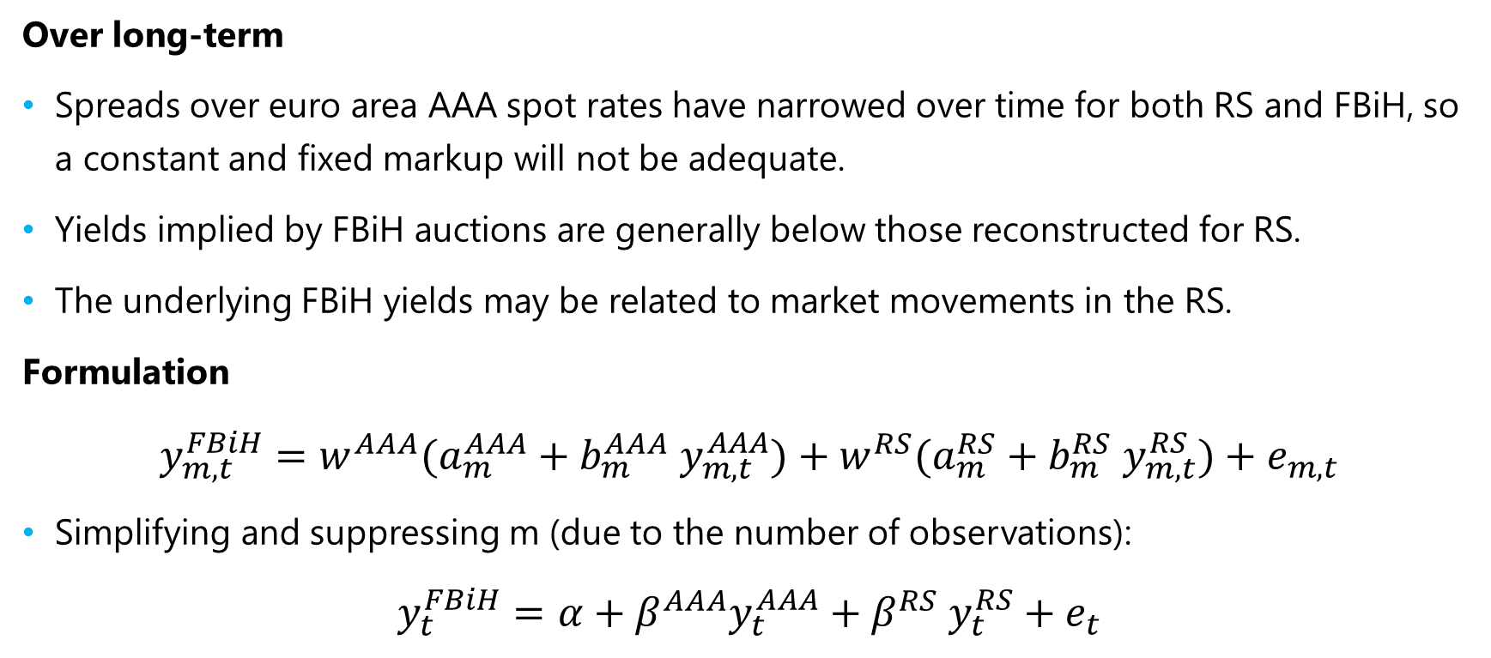
○ Some observations
Over long-term
Spreads over euro area AAA spot rates have narrowed over time for both RS and FBiH, so a constant and fixed markup will not be adequate.
Yields implied by FBiH auctions are generally below those reconstructed for RS.
The underlying FBiH yields may be related to market movements in the RS.
Formulation
$$y_{m, t}^{FBiH}=w^{AAA}(a_{m}^{AAA}+b_{m}^{AAA} y_{m, t}^{AAA})+w^{RS}(a_{m}^{RS}+b_{m}^{RS} y_{m, t}^{RS})+e_{m,t}$$
Simplifying and suppressing m (due to the number of observations):
$$y_{t}^{FBiH}=α+β^{AAA}y_{t}^{AAA}+β^{RS} y_{t}^{RS}+e_{t}$$

Slide 14
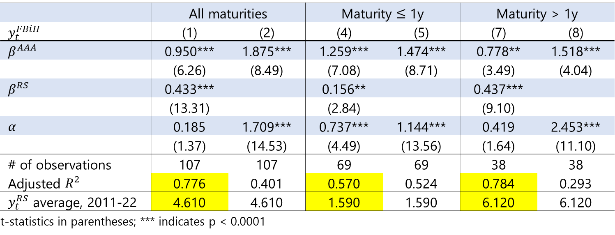

○ Results
FBiH risk-free yields
Accounting for RS yields enhances fit for longer maturities.
Suggested formulation: FBiH yields ≈ euro area AAA yields + 0.5x RS yields
$$y_{t}^{FBiH}=α+β^{AAA}y_{t}^{AAA}+β^{RS} y_{t}^{RS}+e_{t}$$
 | All maturities |  | Maturity $≤$ 1y |  | Maturity > 1y
$y_{t}^{FBiH}$ | (1) | (2) | (4) | (5) | (7) | (8)
$β^{AAA}$ | 0.950*** | 1.875*** | 1.259*** | 1.474*** | 0.778** | 1.518***
 | (6.26) | (8.49) | (7.08) | (8.71) | (3.49) | (4.04)
$β^{RS}$ | 0.433*** |  | 0.156** |  | 0.437***
 | (13.31) |  | (2.84) |  | (9.10)
$α$ | 0.185 | 1.709*** | 0.737*** | 1.144*** | 0.419 | 2.453***
 | (1.37) | (14.53) | (4.49) | (13.56) | (1.64) | (11.10)
# of observations | 107 | 107 | 69 | 69 | 38 | 38
Adjusted $R^{2}$ | 0.776 | 0.401 | 0.570 | 0.524 | 0.784 | 0.293
$y_{t}^{RS}$ average, 2011-22 | 4.610 | 4.610 | 1.590 | 1.590 | 6.120 | 6.120
t-statistics in parentheses; *** indicates p < 0.0001

Slide 15
○ Yields, short-term, inferred
Sources: Staff calculations based on ECB euro area government bond yields, Banja Luka Stock Exchange yield curve parameters, and primary auction data for FBiH government securities.

Slide 16
○ Yields, 1.5-6 years, inferred
Sources: Staff calculations based on ECB euro area government bond yields, Banja Luka Stock Exchange yield curve parameters, and primary auction data for FBiH government securities.

Slide 17
○ Yields, 7-20 years, inferred
Sources: Staff calculations based on ECB euro area government bond yields, Banja Luka Stock Exchange yield curve parameters, and primary auction data for FBiH government securities.

Slide 18
Thank you!

